Slide 1
UNIT- 5

Slide 2
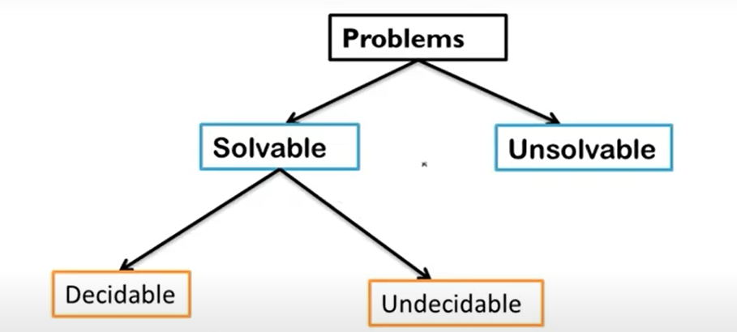
Decidable & Undecidable Problems

Slide 3
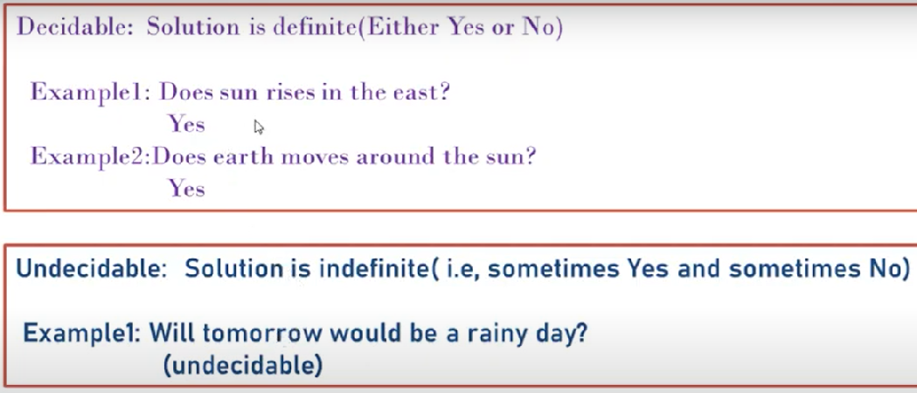
A problem is considered decidable or recursive if it can be solved by an algorithm, a Turing Machine that halts on all inputs after a finite amount of time.
Problems that are not decidable are called undecidable.

Slide 4
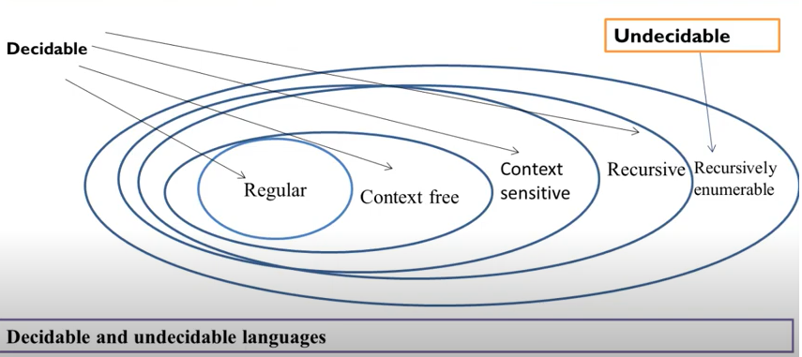

Slide 5
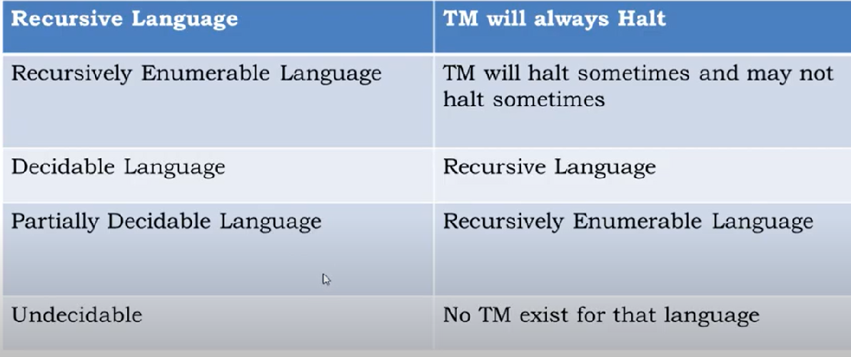

Slide 6
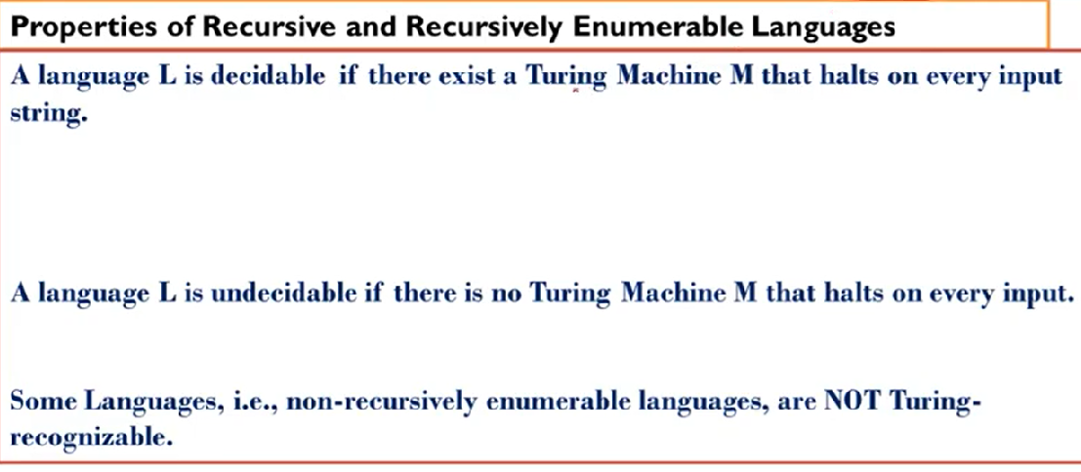
A problem is recursively enumerable (RE) (semidecidable or partially decidable) if there exists a Turing machine that solves the problem in a finite time when the answer to the problem instance is “true” but might not halt in some case when the answer is “false”.

Slide 7
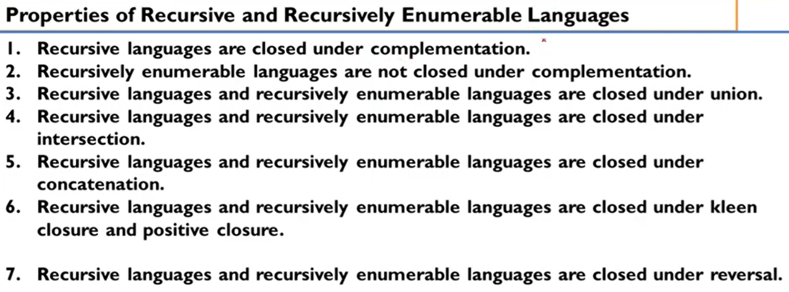

Slide 8
Undecidable Problem about Turing Machine
Reduction is a technique in which if a problem P1 is reduced to a problem P2 then any solution of P2 solves P1.
An algorithm to convert an instance of a problem P1 to an instance of a problem P2 that have the same answer then it is called as P1 reduced P2.
Hence if P1 is not recursive then P2 is also not recursive.
Similarly, if P1 is not recursively enumerable then P2 also is not recursively enumerable.
Theorem: if P1 is reduced to P2 then
If P1 is undecidable, then P2 is also undecidable.
If P1 is non-RE, then P2 is also non-RE.

Slide 9
Proof:
Consider an instance w of P1. Then construct an algorithm such that the algorithm takes instance w as input and converts it into another instance x of P2. Then apply that algorithm to check whether x is in P2. If the algorithm answer 'yes' then that means x is in P2, similarly we can also say that w is in P1. Since we have obtained P2 after reduction of P1. Similarly if algorithm answer 'no' then x is not in P2, that also means w is not in P1. This proves that if P1 is undecidable, then P2 is also undecidable.
Assume that P1 is non-RE but P2 is RE. Construct an algorithm to reduce P1 to P2, but by this algorithm, P2 will be recognized. That means there will be a Turing machine that says 'yes' if the input is P2 but may or may not halt for the input which is not in P2. Convert an instance of w in P1 to an instance x in P2. Then apply a TM to check whether x is in P2. If x is accepted that also means w is accepted. This procedure describes a TM whose language is P1 if w is in P1 then x is also in P2 and if w is not in P1 then x is also not in P2. This proves that if P1 is non-RE then P2 is also non-RE.

Slide 10
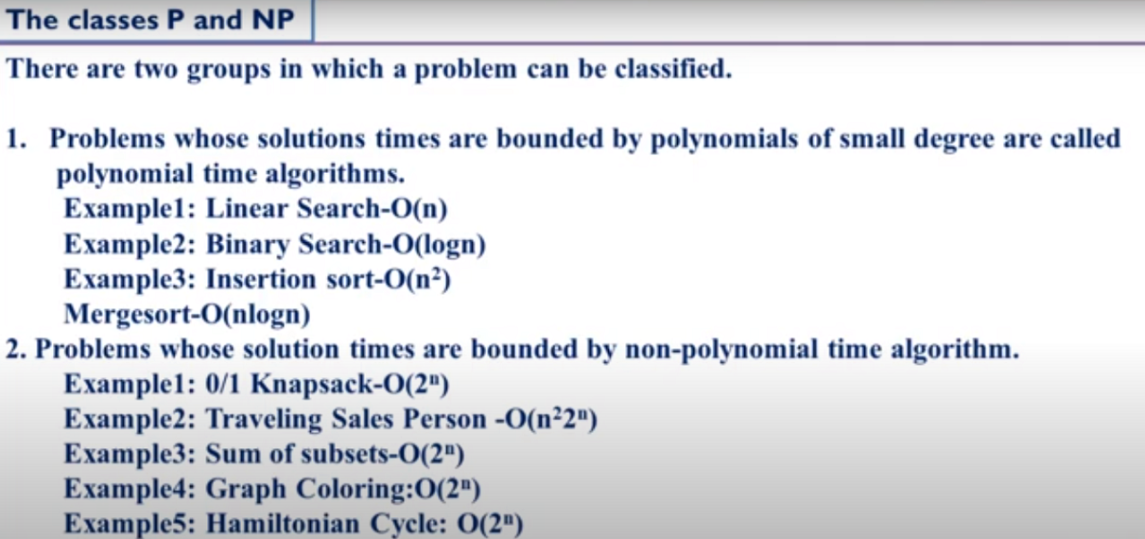

Slide 11
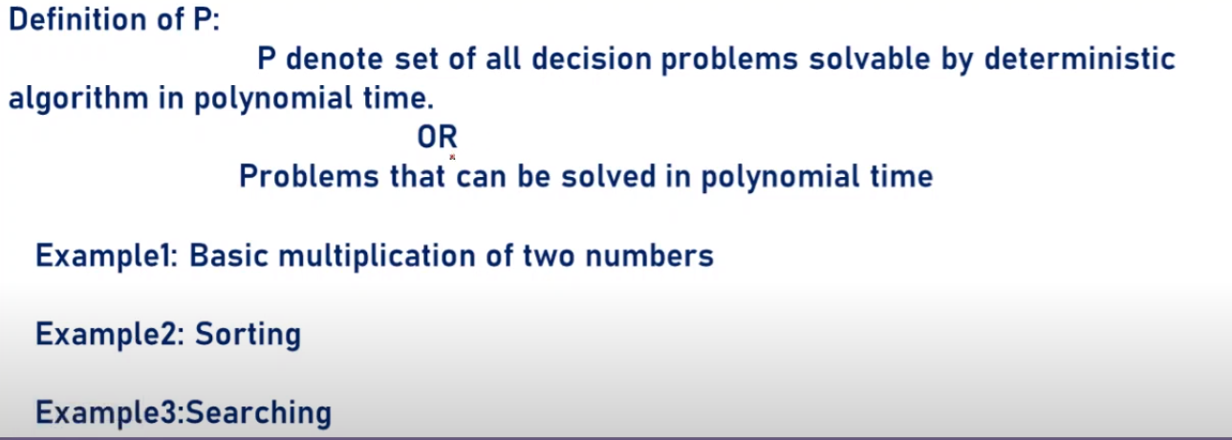

Slide 12
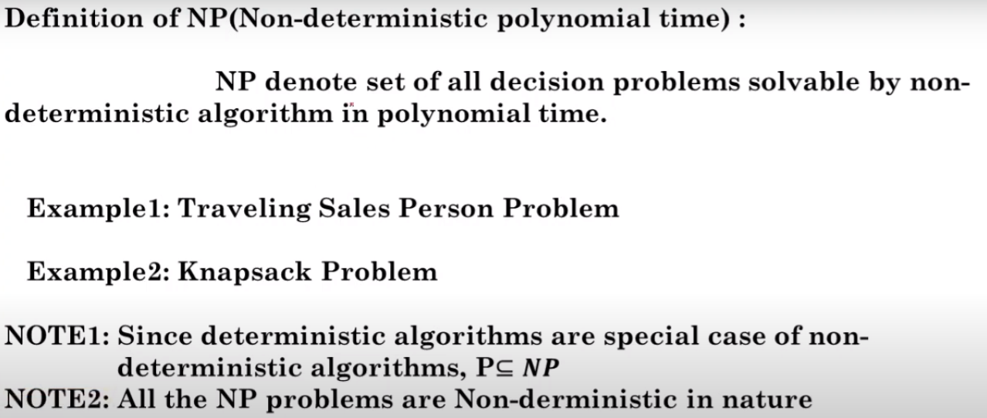

Slide 13
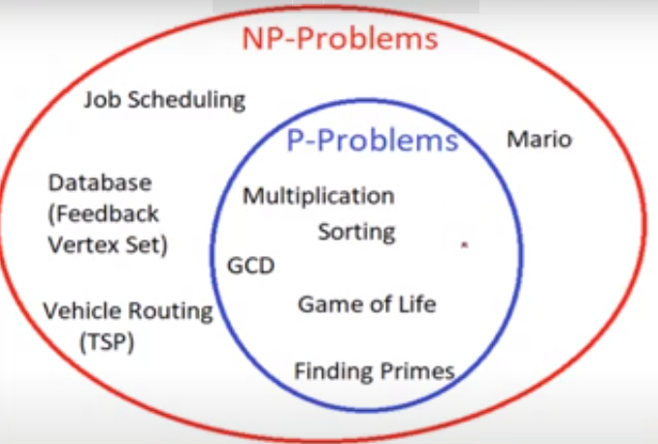

Slide 14
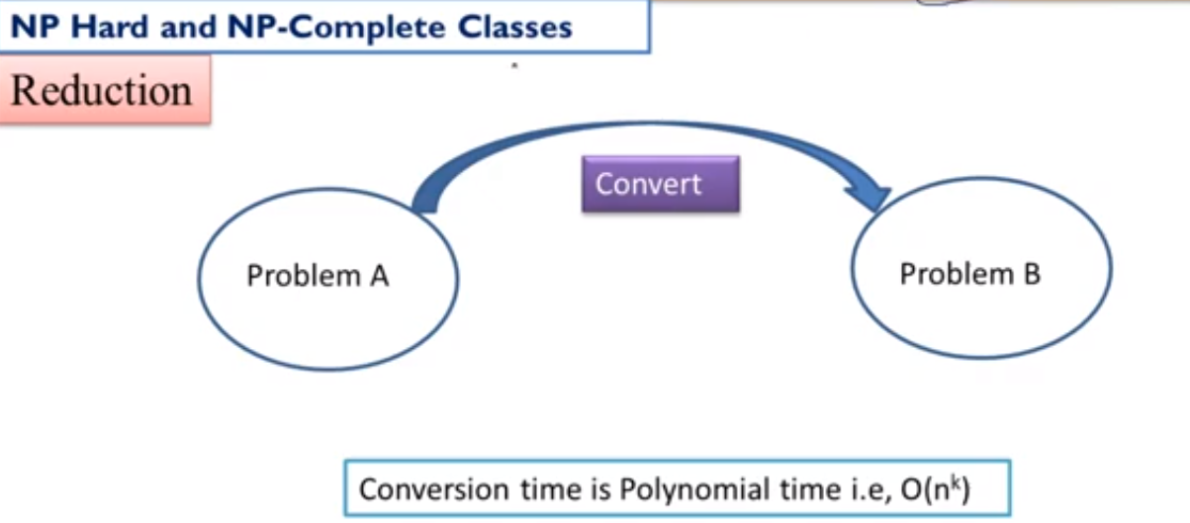

Slide 15
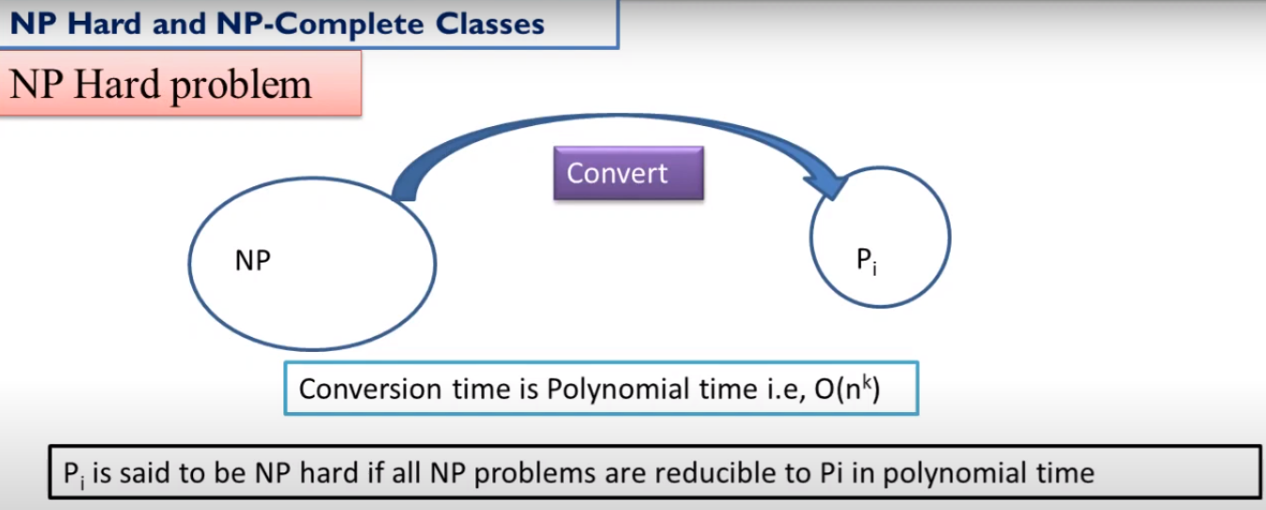

Slide 16
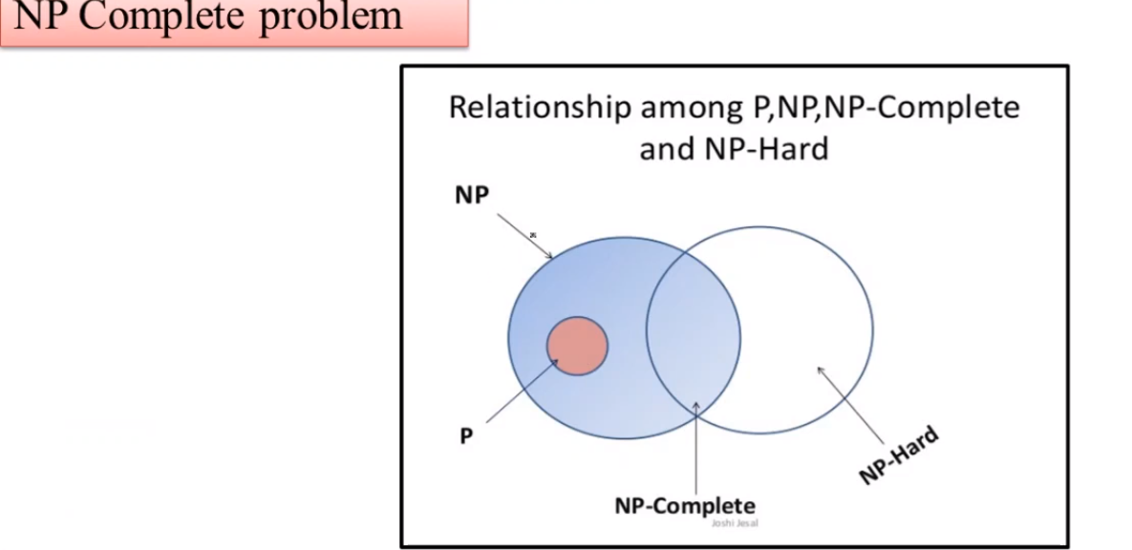

Slide 17
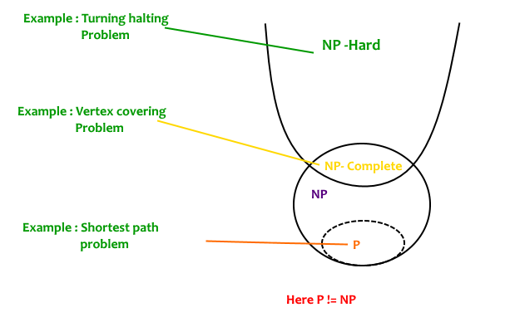

Slide 18
NP Problem: The NP problems set of problems whose solutions are hard to find but easy to verify and are solved by Non-Deterministic Machine in polynomial time.
NP-Hard Problem: A Problem X is NP-Hard if there is an NP-Complete problem Y, such that Y is reducible to X in polynomial time. NP-Hard problems are as hard as NP-Complete problems. NP-Hard Problem need not be in NP class.
NP-Complete Problem: A problem X is NP-Complete if there is an NP problem Y, such that Y is reducible to X in polynomial time. NP-Complete problems are as hard as NP problems. A problem is NP-Complete if it is a part of both NP and NP-Hard Problem. A non-deterministic Turing machine can solve NP-Complete problem in polynomial time.

Slide 19
NP-hard | NP-Complete
NP-Hard problems(say X) can be solved if and only if there is a NP-Complete problem(say Y) that can be reducible into X in polynomial time. | NP-Complete problems can be solved by a non-deterministic Algorithm/Turing Machine in polynomial time.
To solve this problem, it do not have to be in NP . | To solve this problem, it must be both NP and NP-hard problems.
Do not have to be a Decision problem. | It is exclusively a Decision problem.
Example: Halting problem, Vertex cover problem, etc. | Example: Determine whether a graph has a Hamiltonian cycle, Determine whether a Boolean formula is satisfiable or not, Circuit-satisfiability problem, etc.

Slide 20
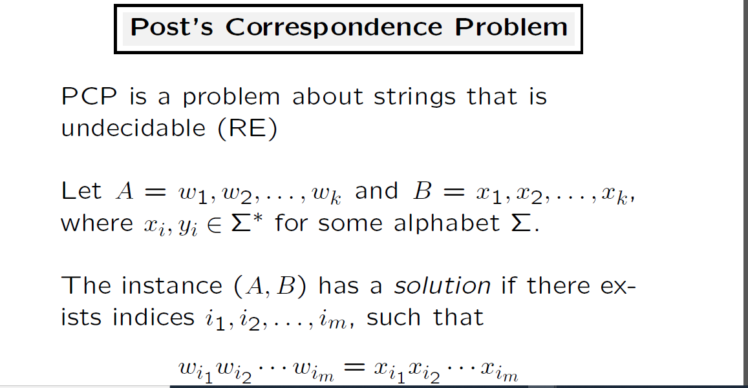

Slide 21
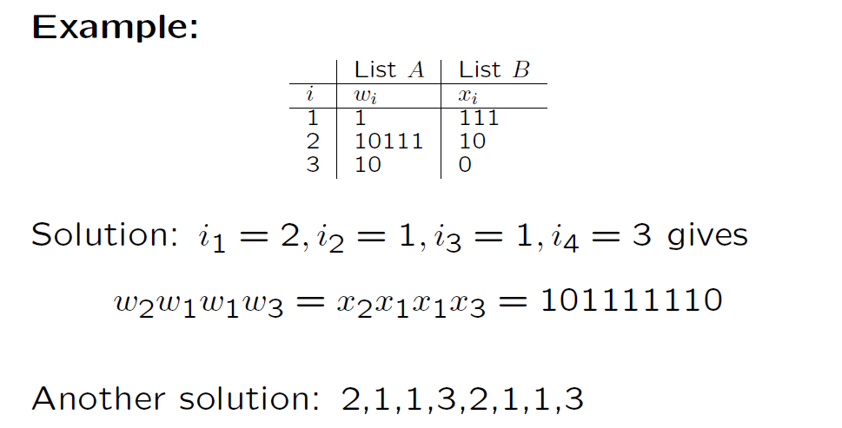

Slide 22
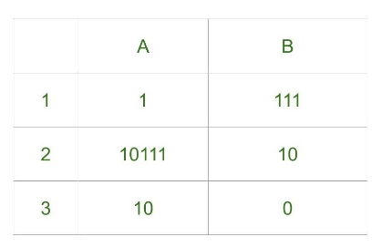
Ex: PCP
Step-1: We will start with tile in which numerator and denominator are starting with same number, so we can start with either 1 or 2. Lets go with second tile, string made by numerator- 10111, string made by denominator is 10.
Step-2: We need 1s in denominator to match 1s in numerator so we will go with first tile, string made by numerator is 10111 1, string made by denominator is 10 111.
Step-3: There is extra 1 in numerator to match this 1 we will add first tile in sequence, string made by numerator is now 10111 1 1, string made by denominator is 10 111 111.
Step-4: Now there is extra 1 in denominator to match it we will add third tile, string made by numerator is 10111 1 1 10, string made by denominator is 10 111 111 0.

Slide 23
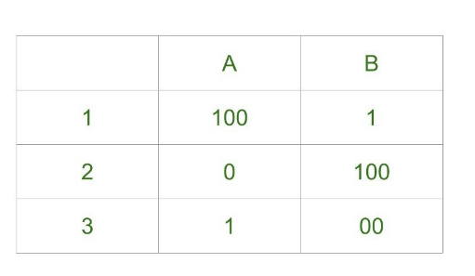
Final Solution - 2 1 1 3
String made by numerators: 101111110
String made by denominators: 101111110

Slide 24
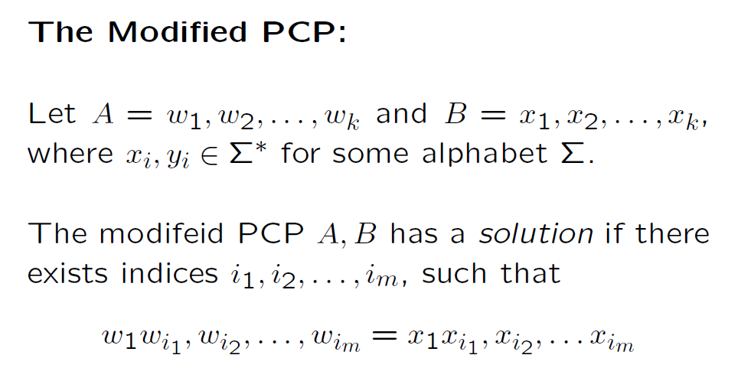

Slide 25
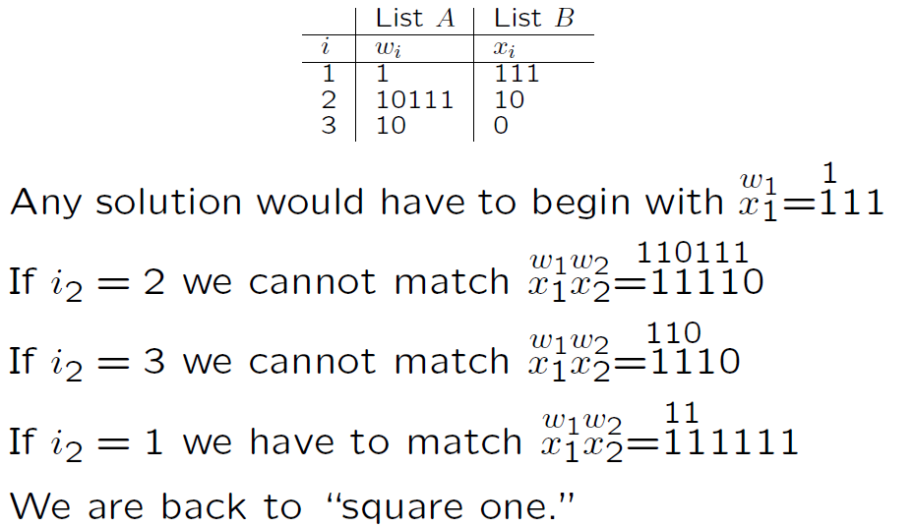

Slide 26
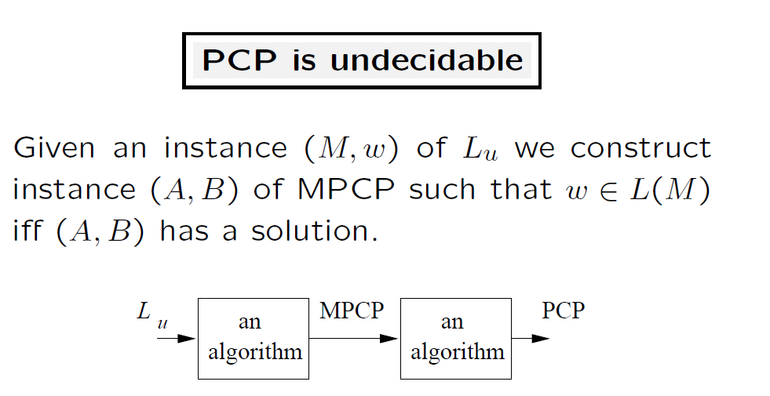

Slide 27
Rules for conversion of MPCP to PCP:
1. Add a symbol (*) after every string in the list(wi ) of MPCP.
2. Add a symbol (*) before every string in the list(xi ) of MPCP.
3. We need to observe that we will have k+2 indexes after conversion of MPCP to PCP.
1. For instance if we have from 1 in MPCP then we start with 0 in PCP such that list(yi ) will have a symbol before 1 index list(yi ) and list(zi ) will have same as of 1 index value in list(zi )
2. Extra Stings in lists are initial and final terminals for identification, i.e.; $ and *$ { list(yi ) and list(zi ) } respectively.

Slide 28

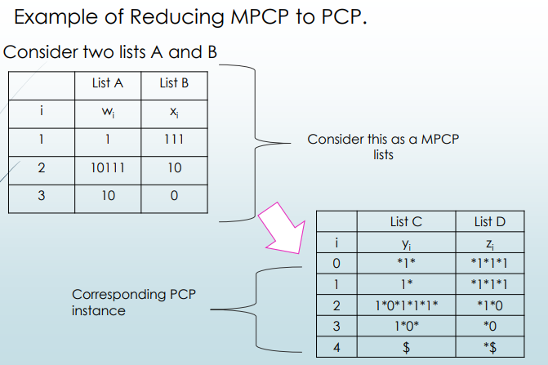

Slide 29
PCP is decidable iff MPCP is decidable.
MPCP have a solution iff PCP have a solution.
MPCP is decidable iff Lu is recursive, where Lu is a language M is Turing machine accepts W string => ATM is decidable. (Assumption)

Slide 30
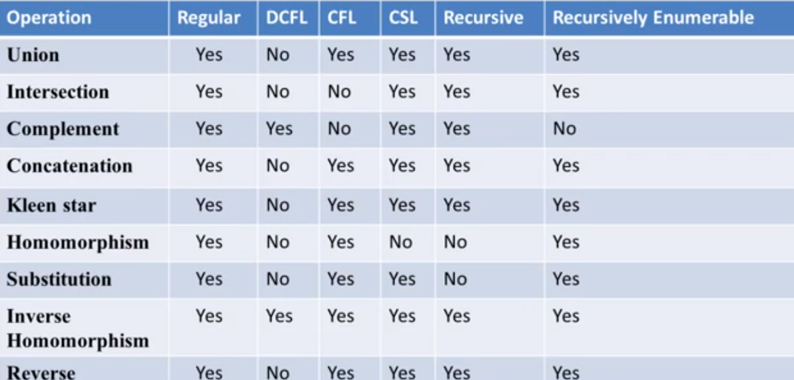

Slide 31
SAT

Slide 32
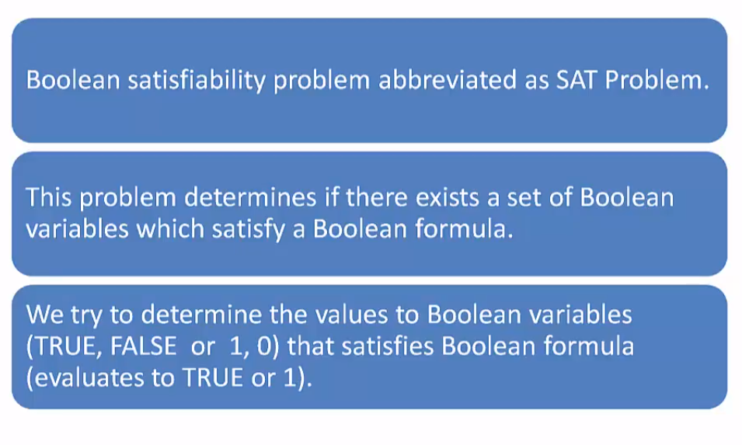

Slide 33
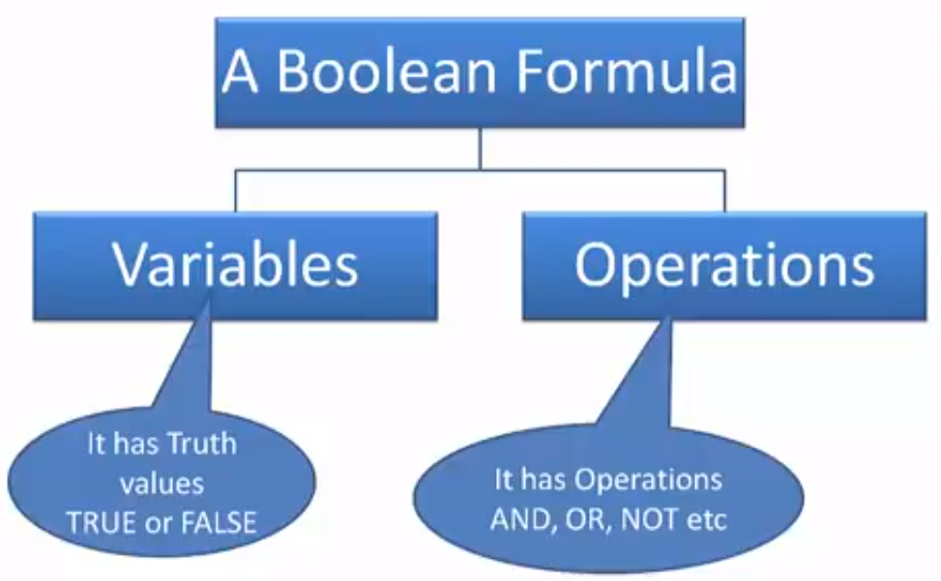

Slide 34
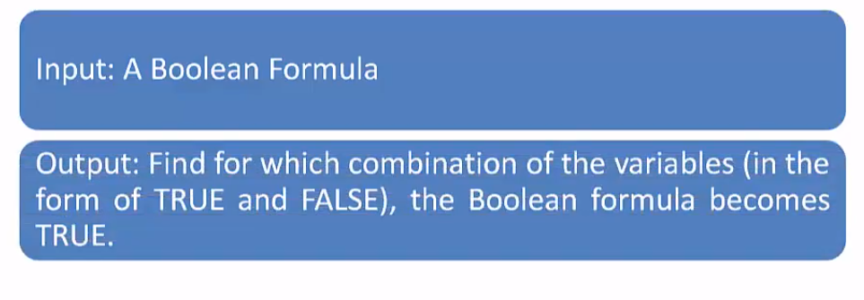

Slide 35
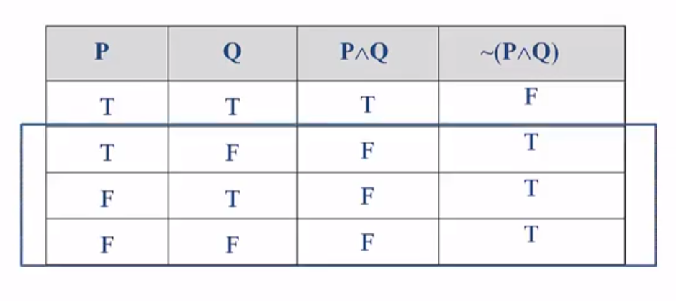

Slide 36
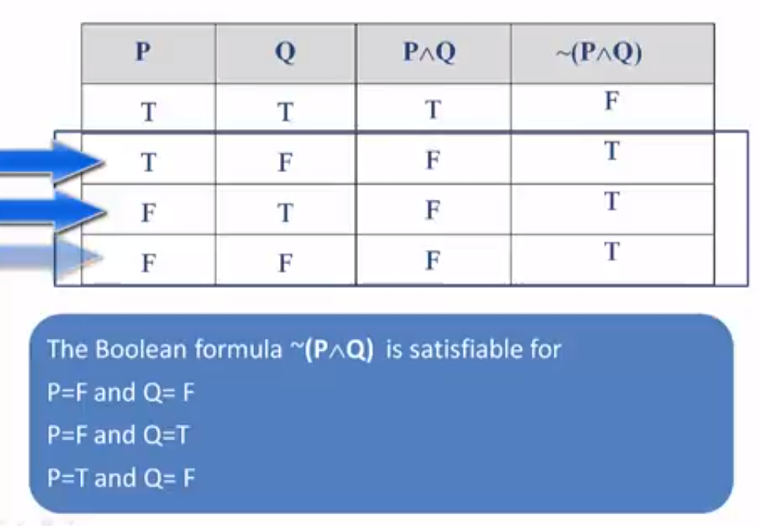

Slide 37
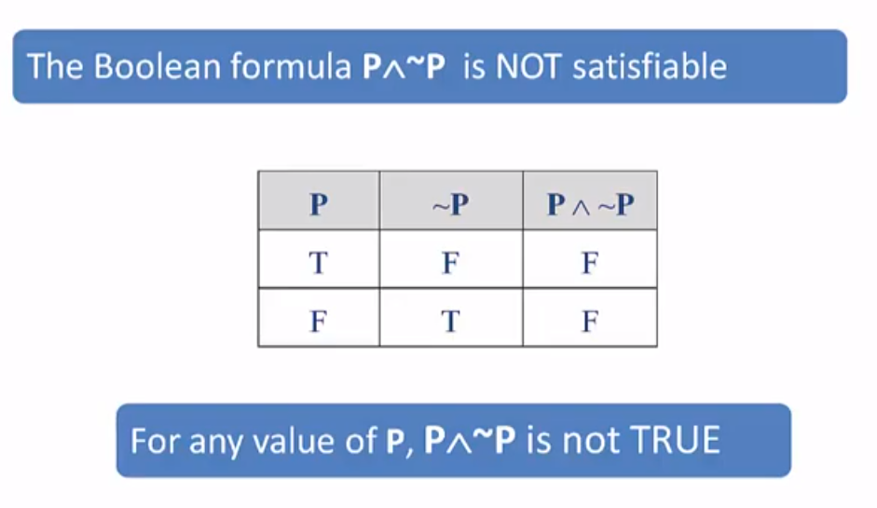

Slide 38
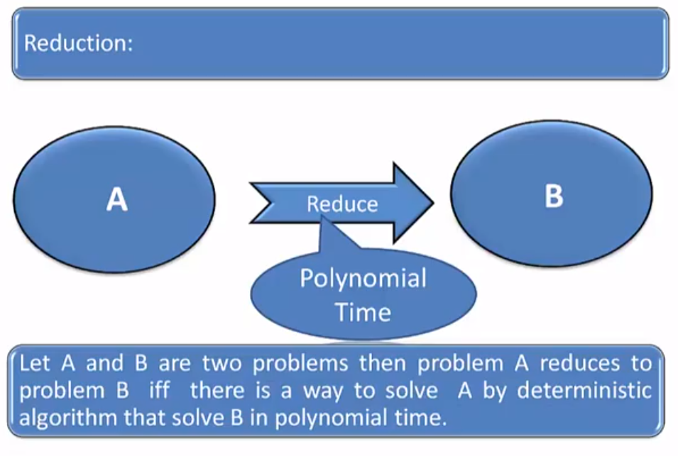

Slide 39
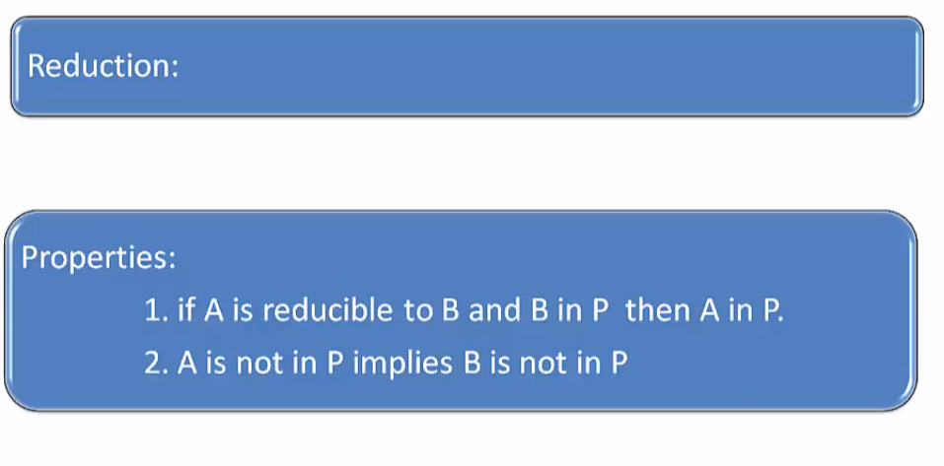

Slide 40
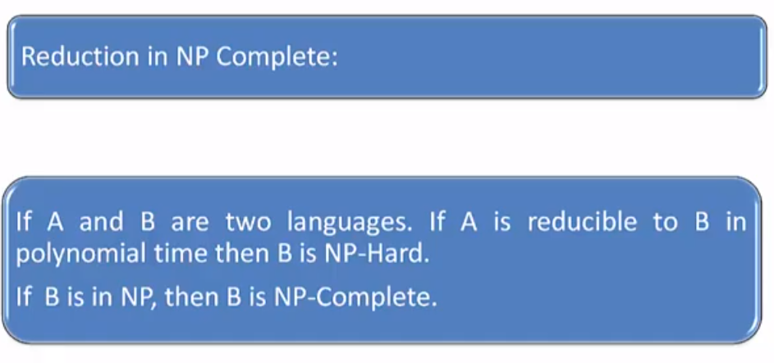

Slide 41
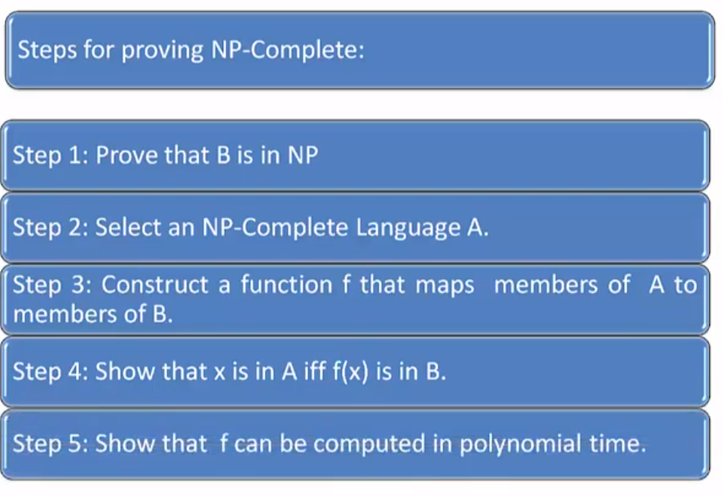

Slide 42
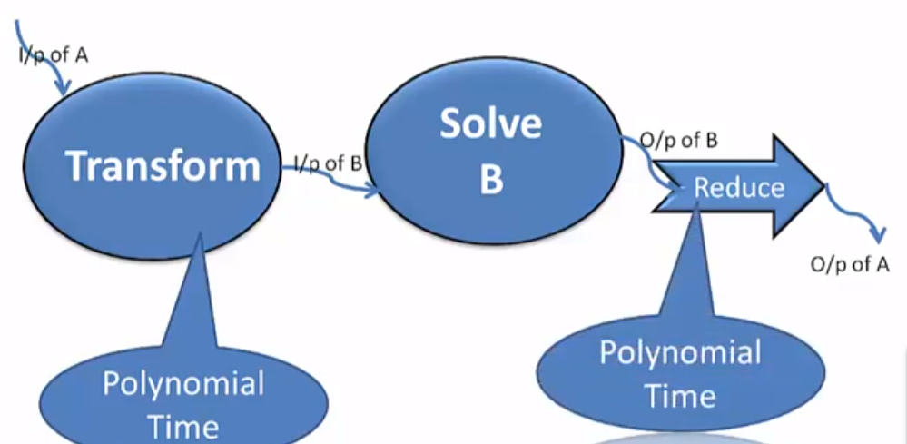

Slide 43
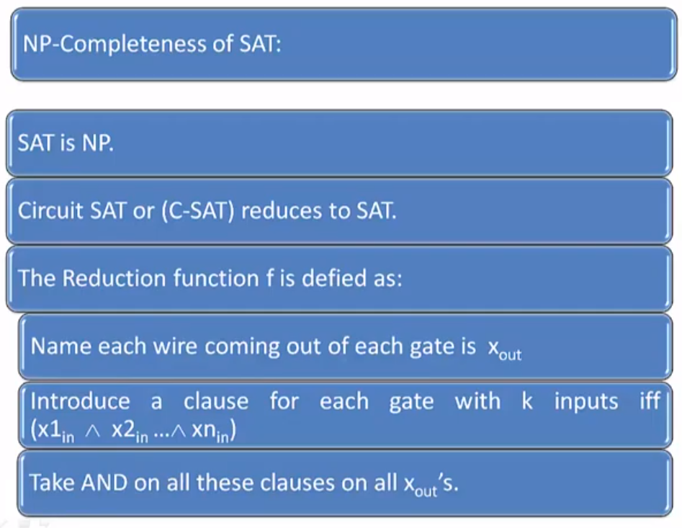

Slide 44
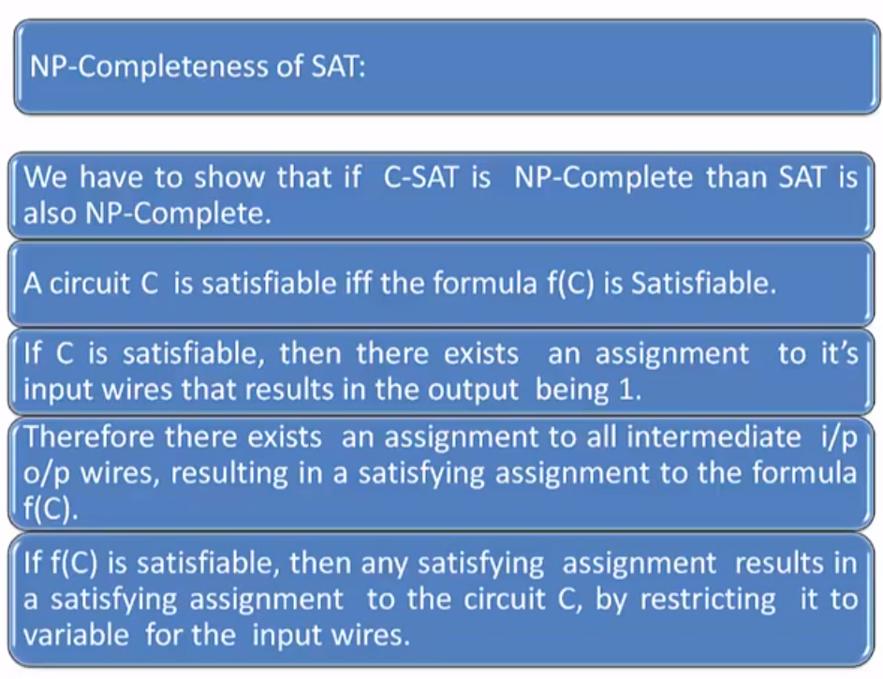

Slide 45
